Slide 1

Random Search Optimization Techniques
By: Amal Tarek

Slide 2
Table of content
Metaheuristics algorithms types
Swarm Intelligence
Swarm Intelligence Algorithms
Ant Colony Optimization
Main Algorithm Components
Pheromone Updates and Calculations
Construction phase
Algorithm parameters
Pros and cons of ACO
Applications
Solve by hand TSP

Slide 3
Metaheuristics Algorithms:
Metaheuristics
Evaluation Based
Nature Inspired
Neighborhood
Genetic algorithms
Swarm Intelligence Ant colony Bee colony
Grasp Simulated annealing

Slide 4
Swarm Intelligence
Swarm Intelligence (SI) is an Artificial Intelligence (AI) discipline that studies the collective behaviors of artificial and natural systems such as those of insects or animals.
The expression was introduced by Gerardo Beni and Jing Wang in 1989.
“Swarm” means a group of objects (people, insects, etc.)

Slide 5
Swarm Intelligence
SI techniques are problem solving techniques emulating this sort of social behaviors that are observed in nature.
In essence, the problem solving ability of an SI technique is derived from the interactions among many simple information processing units (or agents).

Slide 6
Swarm Intelligence Algorithms
Ant Colony
Bee Colony
Gray Wolf Pack
PSO (Particle swarm optimization)

Slide 7
Ant Colony Optimization
Ant colony optimization (ACO) is a population-based iterative metaheuristic that can be used to find approximate solutions to difficult optimization problems.

Slide 8
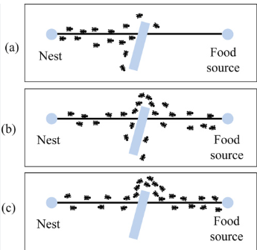
Ant Colony Optimization

Slide 9
Pheromones
Pheromones are organic chemical compounds secreted by the ants that trigger a social response in members of same species.
These are chemicals capable of acting like hormones outside the body of the secreting individual, to impact the behavior of the receiving individuals.
Since most ants live on the ground, they use the soil surface to leave pheromone trails that may be followed (smelled) by other ants.

Slide 10
Pheromones (Fun Fact)
If there is some food and the ants reached it when you kill them some other ants will be searching the space again because of the pheromones.
That's way some chemicals contains substances to erase the pheromone trails.

Slide 11
Ant Colony Optimization
Ant Colony Optimization technique is purely inspired from the behavior of ant colonies.
first introduced by Marco Dorigo in the 1990s.
Ants are social insects that prefer community survival and sustaining rather than as individual species.
They communicate with each other using pheromones.

Slide 12
ACO Main Components
First, m ants construct solutions to the problem instance
The construction is biased by the pheromone information.
Once the ants have completed their solutions, these may be improved in an optional local search phase.
Finally, before the start of the next iteration, the pheromone trails are adapted to reflect the search experience of the ants.

Slide 13
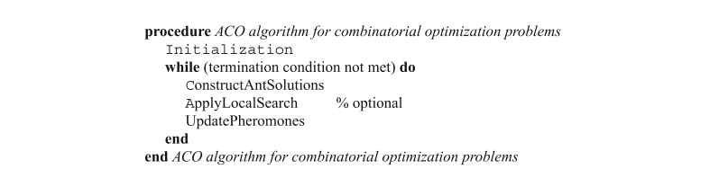
ACO Main Components

Slide 14
Initialization
At the start of the algorithm, parameters are set and all pheromone variables are initialized to a value τ0, which is a parameter of the algorithm.
A set of M ants are chosen to construct the solutions.
After constructing solutions, we must calculate cost for each solution.
A number of iterations must be set to determine the termination criteria.

Slide 15
Pheromones updates:
The pheromone updating step is a critical part of the Ant Colony Optimization (ACO) algorithm.
It mimics the natural process where ants deposit pheromones on paths they travel.
This reinforce good solutions and guiding subsequent ants toward those solutions.
This step ensures the algorithm balances “ exploration of new paths and exploitation of promising solutions”.

Slide 16
Pheromones updates (Pheromone Deposition)
pheromone is deposited on edges used by ants during the current iteration, with better solutions contributing more pheromone.
The deposition of pheromone on edge (i,j)(i, j)(i,j) is calculated as:
τij=τij+∑τijk Where:
Δτijk: Pheromone deposited by ant k on edge (i,j)(i, j)(i,j).
How Δτijk is Calculated
Pheromone deposition depends on the quality of the solution constructed by ant k:
Where:
A constant representing the total amount of pheromone an ant can deposit.
LK The total cost (e.g., path length or objective value) of the solution constructed by ant k.
Better solutions (lower Lk) result in higher pheromone deposition.

Slide 17
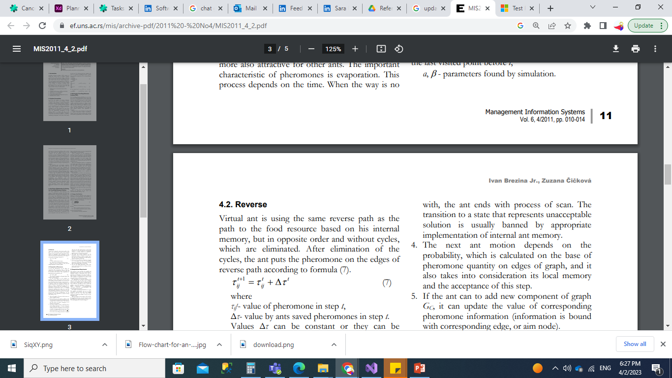
Pheromones updates
where τijt - value of pheromone in step t,
Δτ- value by ants saved pheromones in step t.

Slide 18
Construction phase:
The construction phase in ACO involves:
Initializing the ant at a starting node.
Incrementally building a solution by probabilistically selecting nodes based on pheromone and heuristic information.
Maintaining a tabu list to avoid revisiting nodes (if required by the problem).
Repeating the process until a complete solution is built.
Evaluating the quality of the constructed solution.

Slide 19
Construction phase:
Step-by-Step Process of the Construction Phase
1. Initialization
Each ant starts at a randomly selected node or a predefined starting point (depending on the problem, e.g., a specific city in the Traveling Salesman Problem (TSP)).
The ant maintains a tabu list (or memory), which keeps track of the nodes it has already visited to avoid revisiting them (if the problem requires visiting each node only once, as in TSP).

Slide 20
Construction phase:
2. Move to the Next Node
At each step, the ant decides which node to move to next. This decision is based on pheromone levels and heuristic information for the edges connected to the current node. The steps are as follows:
a. Identify Allowed Nodes
From the current node, find all neighboring nodes that the ant has not yet visited. These nodes form the allowed set of nodes.

Slide 21
Construction phase:
b. Calculate Transition Probabilities
For each node jjj in the allowed set, calculate the probability PijP_{ij}Pij​ of the ant moving from node iii to node jjj using the formula: Where:
τij: Pheromone level on the edge between nodes iii and jjj.
ηij​: Heuristic information (i.e. the distance between nodes iii and jjj in TSP).
α\alphaα: Parameter controlling the influence of pheromone (τ\tauτ).
β\betaβ: Parameter controlling the influence of heuristic information (η\etaη).
Allowed set: Nodes that the ant has not yet visited.

Slide 22
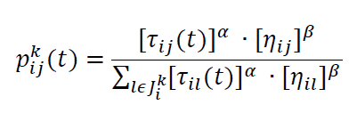
Construction phase (based on pheromone matrix )

Slide 23
Construction phase:
c. Select the Next Node
Use the calculated probabilities to probabilistically choose the next node using a roulette wheel selection or similar stochastic method:
Higher Pij​: Higher likelihood of selecting node jjj.
This step balances exploration (based on heuristic information) and exploitation (based on pheromone levels).

Slide 24
Construction phase:
c. Select the Next Node
Use the calculated probabilities to probabilistically choose the next node using a roulette wheel selection or similar methods:
Higher Pij​: Higher likelihood of selecting node jjj.
This step balances exploration (based on heuristic information) and exploitation (based on pheromone levels).

Slide 25
Construction phase:
3- Repeat Step 2 Until the Solution is Complete
The ant continues selecting nodes and adding them to its solution until:
It has visited all required nodes (e.g., all cities in TSP).
Or it satisfies the problem-specific stopping condition (e.g., reaching a target state).

Slide 26
Construction phase:
4- Evaluate the Constructed Solution
Once the ant completes its solution, evaluate its quality (e.g., total path length for TSP, total cost for a combinatorial optimization problem).
The quality of the solution will later influence pheromone updates in the next phase of the ACO algorithm.

Slide 27
Example:
Initial Solutions
Distance Matrix (Cost Matrix)
A1: C1-C2-C3-C4 total Cost= 12
A2: C1-C2-C4-C3 total Cost= 7
A3: C4-C1-C2-C3 total Cost= 13
A4: C2-C4-C1-C3 total Cost= 13
#0 | C1 | C2 | C3 | C4
C1 | 0 | 1 | 3 | 4
C2 | 1 | 0 | 5 | 1
C3 | 3 | 5 | 0 | 2
C4 | 4 | 1 | 2 | 0
Update Pheromones Matrix:
Equation
T1🡪2=1/12 +1/7+1/13
T1🡪3=1/13
T3🡪1=1/7
T1🡪4=0
T4🡪1=1/12+1/13+1/13
Pheromone Matrix
#0 | C1 | C2 | C3 | C4
C1 | 0 | 0.303 | 0.07 | 0
C2 | 0 | 0 | 0.16 | 0.2
C3 | 0.14 | 0.07 | 0 | 0.16
C4 | 0.23 | 0 | 0.14 | 0

Slide 28
Example:
Solution Construction : 1- calculate probabilities
P1🡺2 (0.3 * (1/1))/(0.3*(1) +(0.07*1\3)+(0*1/4))=0.6
P1🡺3 (0.07 * (1/3))/(0.3*(1) +(0.07*1\3)+(0*1/4))=0.4
P1🡺4 (0.0 * (1/1))/(0.3*(1) +(0.07*1\3)+(0*1/4))=0
Calculate CDF from calculated Probabilities:
Generate Random Number from 0 🡪 1
Get city associated with the range

Slide 29
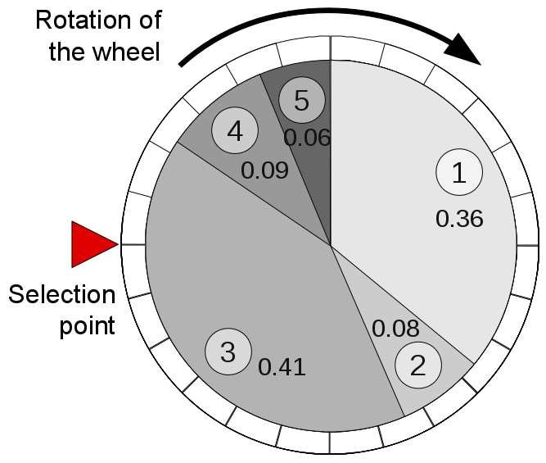

Roulette wheel:

Slide 30
Did You Notice Something!

Slide 31
Stagnation:
Description: Over time, pheromone levels on certain paths may dominate, causing all ants to follow the same paths and reducing diversity in the search.
Reasons:
Without sufficient pheromone evaporation (ρ\rhoρ), pheromone levels accumulate excessively on a small subset of edges.
This leads to loss of exploration and stagnation in suboptimal solutions.
Impact: The algorithm becomes less able to adapt to new or better solutions.

Slide 32
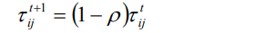
Pheromones Evaporation:
Evaporation of Pheromones:
Pheromone evaporation reduces the pheromone level on all edges to avoid unlimited accumulation and encourage exploration of new paths.
This evaporation of pheromones has an intensity ρ
This step reduces the influence of outdated or suboptimal solutions.

Slide 33
Construction Parameters:
Parameters α and β determine the relative influence of the pheromone trails and the heuristic information and have the following influence on the algorithm behavior.
If α = 0, the selection probabilities are proportional to [ηij] β and a solution component with a high heuristic value will more likely be selected: this case corresponds to a stochastic greedy algorithm.
If β = 0, only pheromone amplification is at work.

Slide 34
Construction Parameters:
α (alpha): The importance of pheromone trails.
Alpha determines how much influence the pheromone levels (τij) have on the ants’ decisions.
A higher value of α means that the ants will rely more heavily on the pheromone trails, favoring paths that have been frequently used by previous ants.
β (beta): The importance of heuristic information.
Beta determines how much influence the heuristic values (ηij​) have on the ants’ decisions.
A higher value of β means that ants will rely more on the problem-specific heuristic information (e.g., distance between nodes in the Traveling Salesman Problem), favoring paths that look more promising based on local information.

Slide 35
Applications:
Routing.
Network Design.
Supply Chain.
Feature Selection.

Slide 36
Issues Faced:
Lack of Memory
Description: ACO does not explicitly retain memory of previously explored solutions (other than through pheromone trails), which can limit its efficiency.
Reasons:
Historical knowledge is encoded only in pheromone trails, which are subject to evaporation.
The algorithm may end up revisiting poor solutions once their pheromone levels are reduced.
Impact: ACO may waste computational effort by exploring already-known inferior regions of the search space.

Slide 37
Thank you!

